Slide 1
Playground Series- Tabular Regression with the California Housing Dataset
By
Sriya Gorrepati
Yingying Deng

Slide 2
Overview
The Playground Series, hosted on Kaggle, offers a range of data science and machine learning challenges.
The series aims to provide the Kaggle community with accessible, skill-building opportunities in various areas of ML and data science.
Season 3, Episode 1 of the Playground Series is a Tabular Regression competition featuring the California Housing Dataset.
Competitors will create a model to predict median housing prices in neighborhoods using the provided data.

Slide 3
Dataset and Challenges
The dataset for this competition (both train and test) was generated from a deep learning model trained on the California Housing Dataset.
Feature distributions are close but not exactly same as the original california dataset.
The test data has 24760 rows and 9 attributes.
The train data has 37138 rows and 10 attributes,
Target variable- MedHouseVal- Median house value for households within a block.
Incorporate california_dataset to gain in training dataset to improve performance of the model.

Slide 4
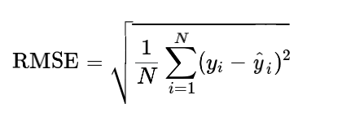
Evaluation Metric
Root Mean Squared Error (RMSE)
Measures the difference between the predicted and actual values.
A lower RMSE value indicates a more accurate model, making it a suitable evaluation metric for this challenge.

Slide 5
Models
RandomForestRegressor()
LinearRegression()
GradientBoostingRegressor()
XGBRegressor()

Slide 6
Data Preprocessing
Looking for any non-numerical data and converting it into numerical data.
Extract features
Checking for missing values.

Slide 7
Data Exploration
Using latitudes and longitudes columns of the dataset.
Longitude: How far west a house is;
Latitude: How far north a house is.
Useful to find out aggregate statistics about surrounding area. Gives information on which area point has more population.
Use reverse geocode package.
Plotting histograms for training set and heatmaps of correlations for training and testing.

Slide 8
Thankyou!

